Slide 1


Cooperative Driving of Connected Autonomous Vehicles Using Responsibility-Sensitive Safety (RSS) Rules
Mohammad Khayatian¹, Mohammadreza Mehrabian¹, Harshith Allamsetti², Kai-Wei Liu³, Po-Yu Huang³, Chung-Wei Lin³, Aviral Shrivastava¹
¹Arizona State University,²Western Digital,³National Taiwan University

Slide 2
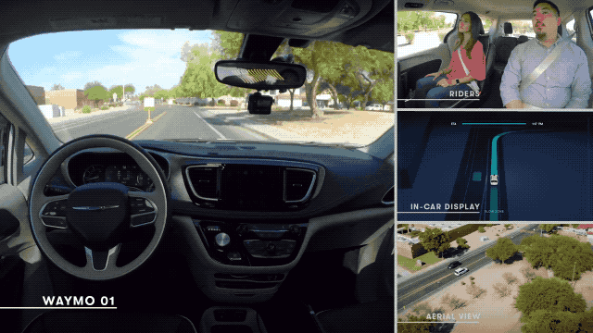
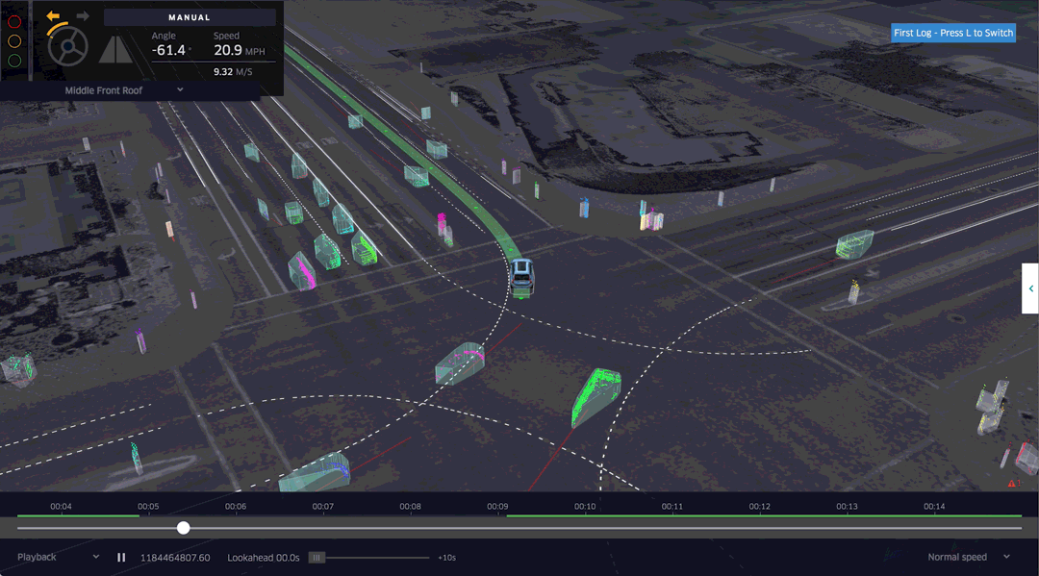
Autonomous Vehicle (AV)
Autonomous vehicles are no more a dream!
Waymo now offers driverless taxi rides to the public in the Phoenix area
Many other AV companies are actively testing their vehicle in the Phoenix area
Global AV market is expected to reach $556.67 billion by 2026

Slide 3
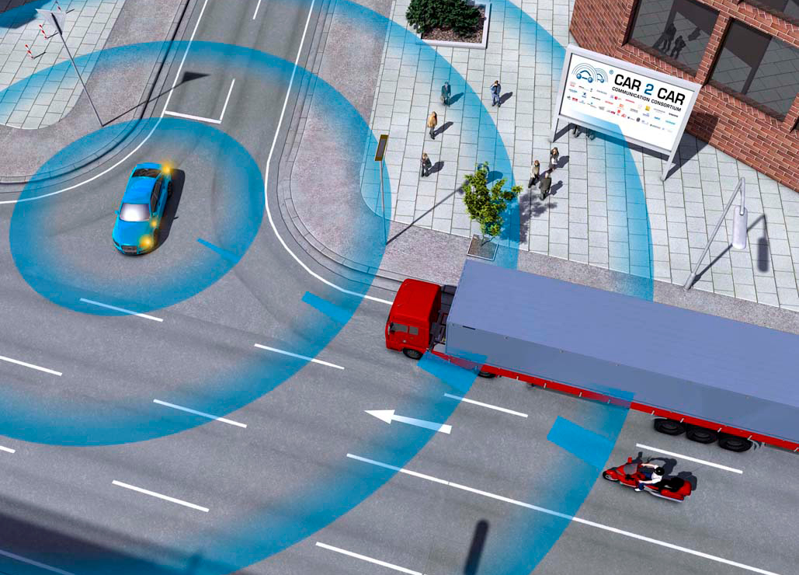
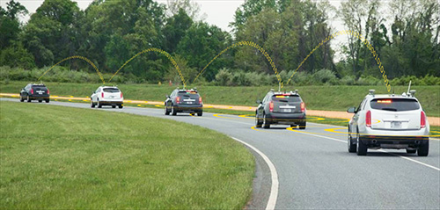
Connected Autonomous Vehicles (CAVs)
CAVs can be safer than AVs
Inform others of their presence (position) and their future plan (XY-coordinates and velocity profile)
CAVs can be more efficient compared to AVs
Cooperative motion planning e.g., platooning for reducing fuel consumption (reducing the air drag)
Existing communication technology
DSRC (Dedicated Short-Range Communication)
Cellular-V2X (3GPP)
5G

Slide 4
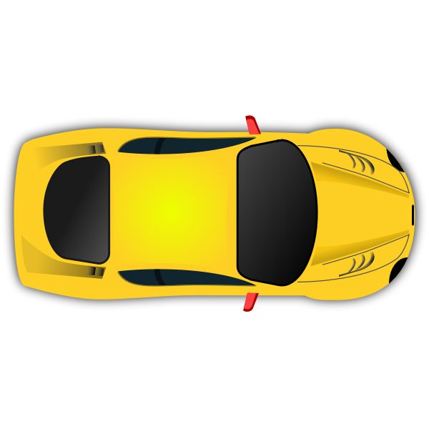
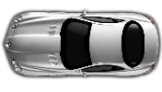
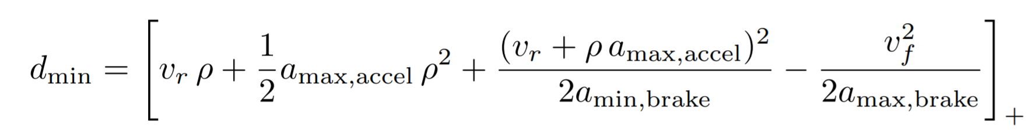
Responsibility-Sensitive Safety (RSS) Rules
RSS rules [1] are safety rules developed by Intel+Mobileye for AVs
Main idea: The ego AV may be unable to avoid “all accidents”, but it can avoid accidents that it is blamed for.
Two main rules:
Longitudinal scenario
Lateral scenario
“Longest” braking distance of the ego vehicle
“Shortest” braking distance of the front vehicle
Ego
Front
[1] Shalev-Shwartz, Shai, Shaked Shammah, and Amnon Shashua. "On a formal model of safe and scalable self-driving cars." arXiv preprint arXiv:1708.06374 (2017).

Slide 5
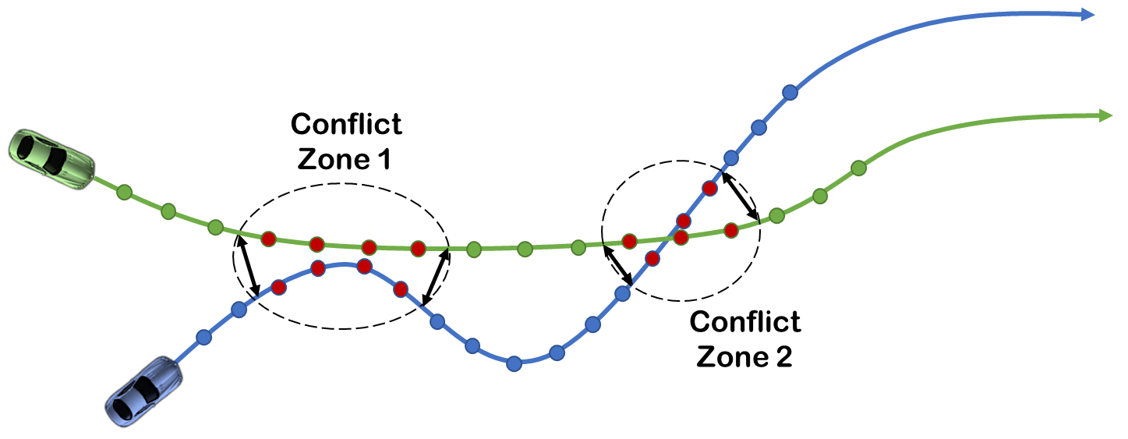
RSS Rules for Connected Autonomous Vehicles
Conflict zone: the area where the distance between future paths of two CAVs is less than a threshold
Advantage: the advantage is computed by the rules-of-the-road by default and if it is not explicitly defined, the CAV with earlier arrival time at the conflict zone has the advantage.

Slide 6
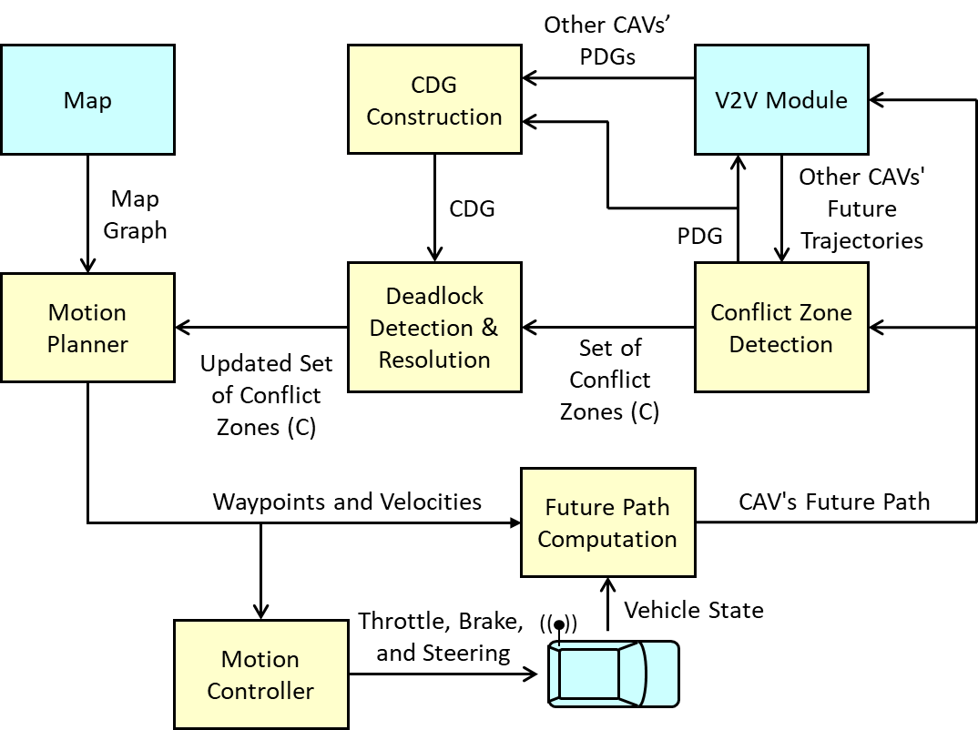
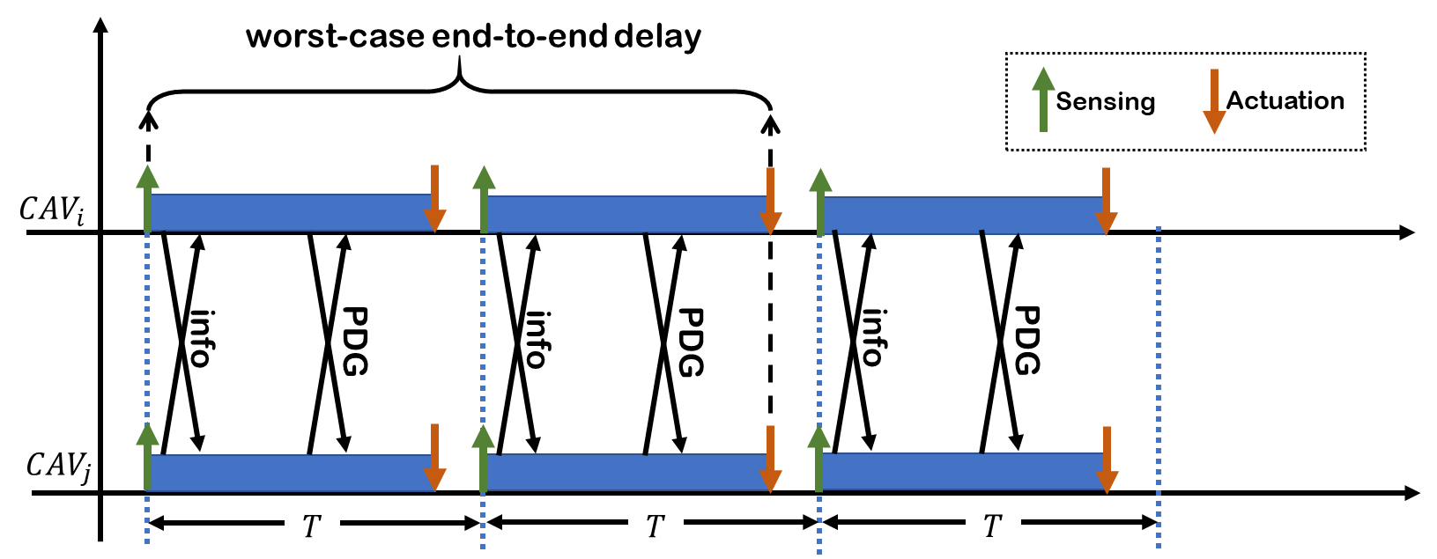
Cooperative Conflict Resolution
1) Each CAV computes its future path and broadcasts it along with other info (ID, position, velocity, etc.)
2) Upon receiving paths of other CAVs, the ego CAV detects if there are conflict zones
3) The ego CAV determines if it has the advantage/disadvantage for detected conflict zones
4) The Partial Dependency Graph (PDG) is computed and broadcast
5) Upon receiving PDGs of other CAVs, the Complete Dependency Graph (PDG) is constructed
6) Deadlocks are resolved (if any)
7) Motion planner acts if the ego CAV has a disadvantage over a conflict zone

Slide 7
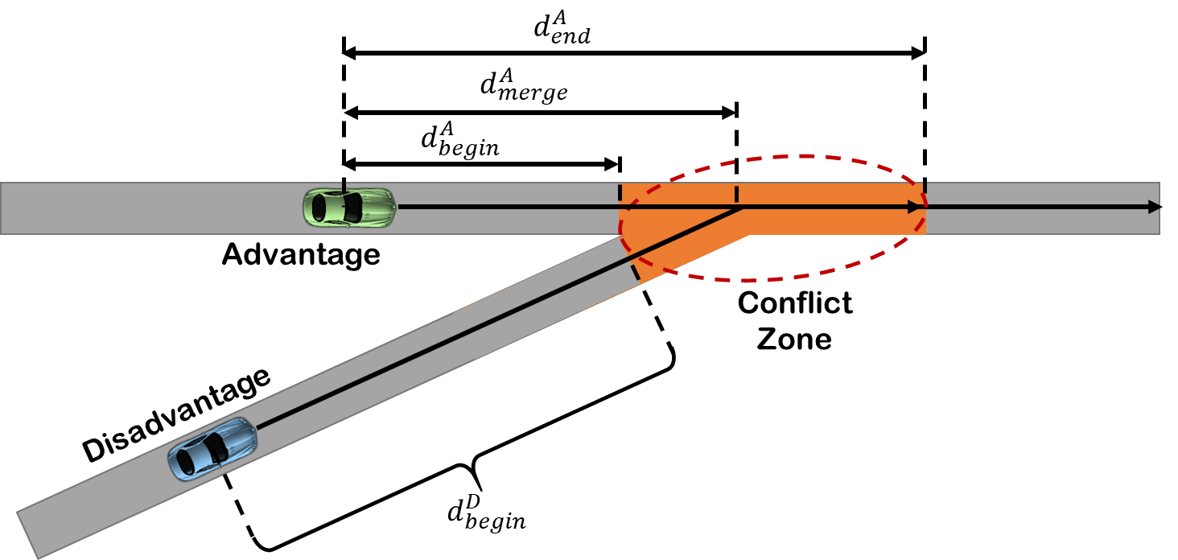
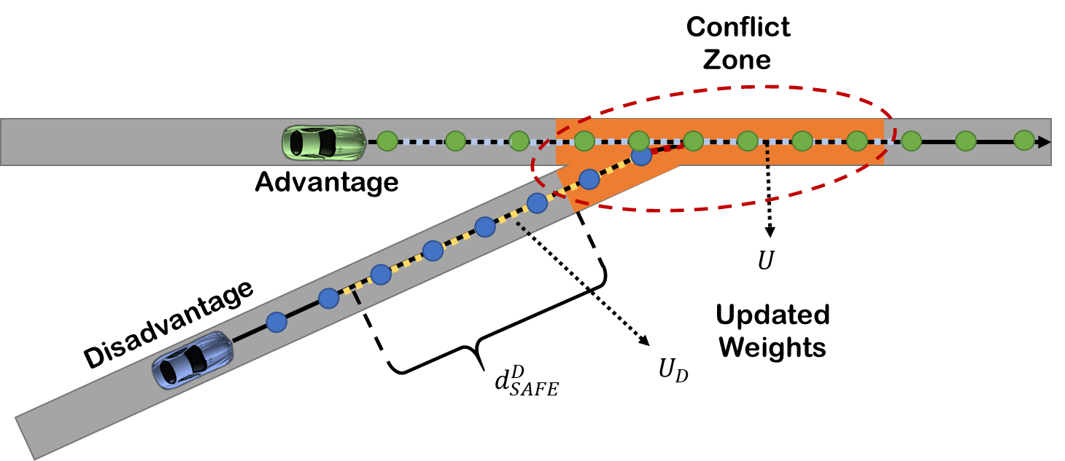
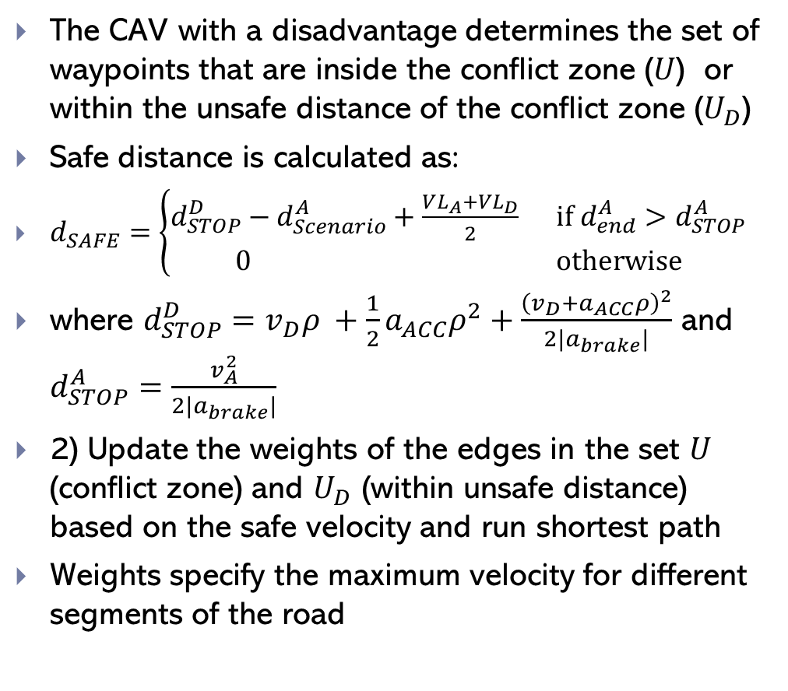
Motion Planning
The CAV with a disadvantage determines the set of waypoints that are inside the conflict zone ($U$) or within the unsafe distance of the conflict zone ($U_{D}$)
Safe distance is calculated as:
$d_{SAFE}=\left\{\begin{aligned}d_{STOP}^{D}−d_{Scenario}^{A}+\frac{VL_{A}+VL_{D}}{2} if d_{end}^{A}>d_{STOP}^{A} \\ 0 otherwise\end{aligned}\right.$
where $d_{STOP}^{D}=v_{D}ρ +\frac{1}{2}a_{ACC}ρ^{2}+\frac{{\left(v_{D}+a_{ACC}ρ\right)}^{2}}{2|a_{brake}|}$ and $d_{STOP}^{A}=\frac{v_{A}^{2}}{2|a_{brake}|}$
2) Update the weights of the edges in the set $U$ (conflict zone) and $U_{D}$ (within unsafe distance) based on the safe velocity and run shortest path
Weights specify the maximum velocity for different segments of the road

Slide 8
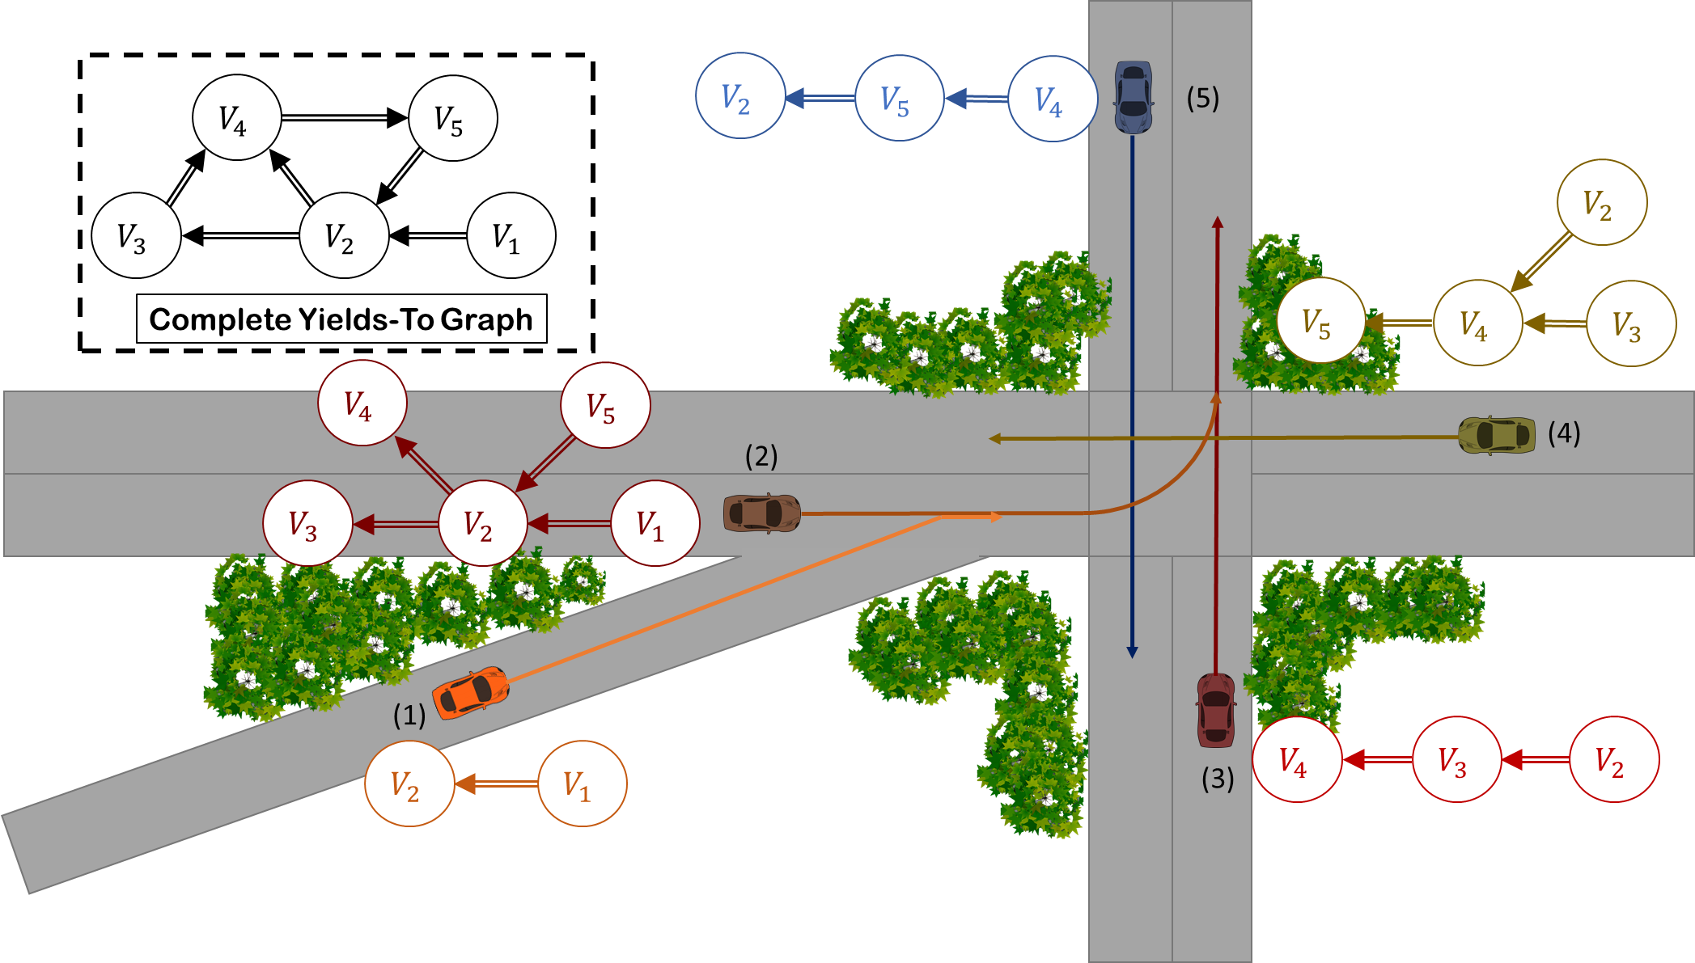
Deadlock Detection and Resolution
CAVs broadcast the partial yields-to graph
Receive others partial graph and construct the complete yields-to graph
If there is a cycle in the complete yields-to graph, then there can be a deadlock.
The Cycle is removed by selecting a leader (the CAV with earliest average arrival time at its conflict zones) and reversing its outgoing edges.
If two CAVs have the same average arrival time, the CAV with higher ID is selected to break the tie.

Slide 9
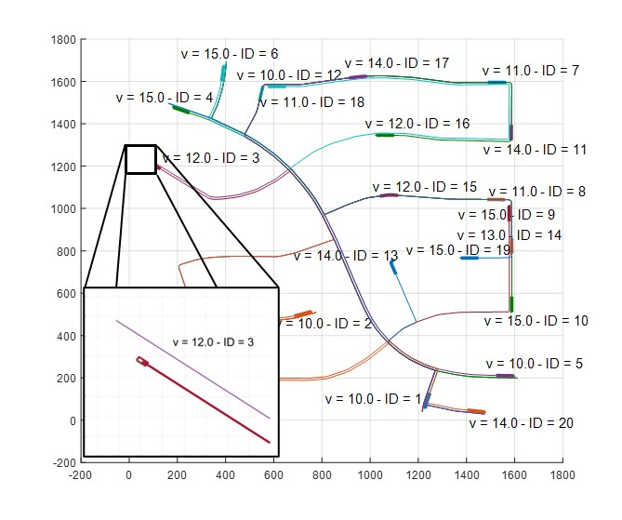
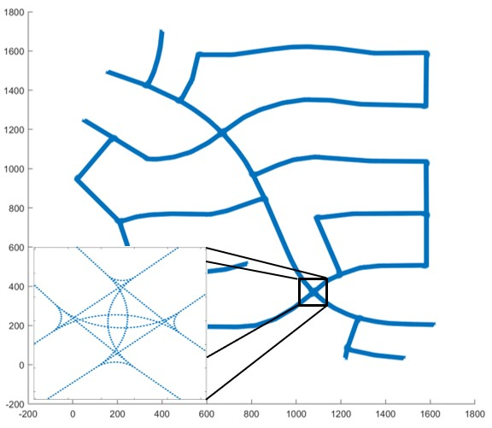
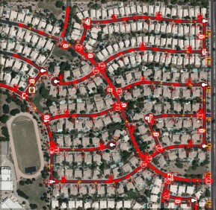
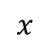

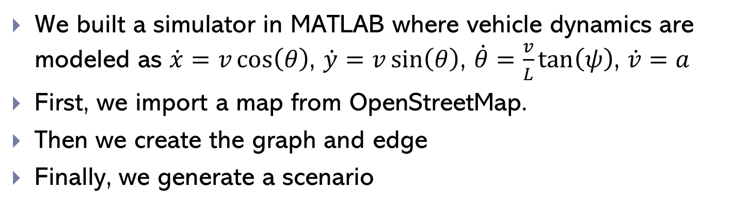

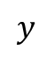
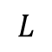
Testbed
$$ψ$$
We built a simulator in MATLAB where vehicle dynamics are modeled as $\dot{x}=v\cos\left(θ\right)$, $\dot{y}=v\sin\left(θ\right)$, $\dot{θ}=\frac{v}{L}\tan\left(ψ\right)$, $\dot{v}=a$
First, we import a map from OpenStreetMap.
Then we create the graph and edge
Finally, we generate a scenario
$$φ$$
$$y$$
$$L$$
$$x$$

Slide 10
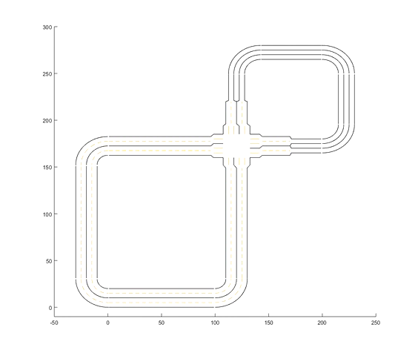
Demo
Two loops
The large loop has two lanes per road
The smaller loop has one lane per road
A 4-way intersection
Two merging points
CAVs are initialized with a desired velocity and fixed destination
The destination is modified when it is reached

Slide 11
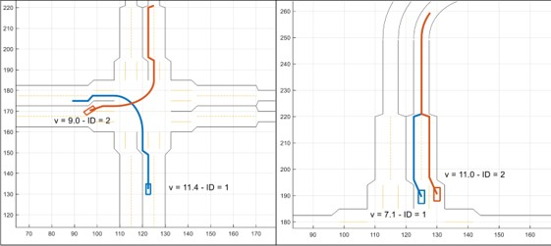
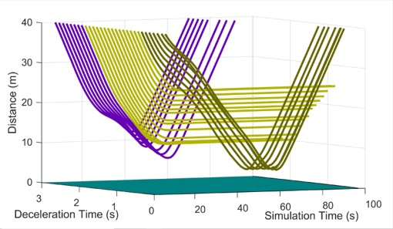
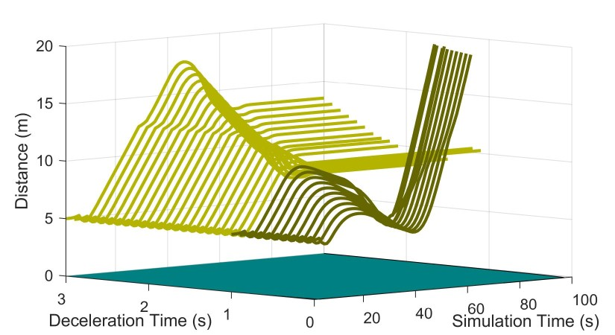
Brute Force Safety Analysis
Stationary conflict zone
Dynamic conflict zone
Two scenarios: 1) merge, 2) intersection
The CAV with advantage (orange) applies maximum brake (at different times for different simulations)
The CAV with advantage may stop after (blue), inside (yellow) or before (dark green) the conflict zone

Slide 12
Conclusion and Future Work
We developed a new set of RSS rules for Connected Autonomous Vehicles (CAVs)
We developed the complete framework for cooperation of CAVs (Conflict detection, deadlock detection and resolution, motion planning, and control)
We developed a simulator to verify our algorithm and under the worst-case scenario CAVs remain safe
In the future, we plan to extend our work by considering human drivers and using optimization-based approaches for determining the advantage

Slide 13

Question?

